Slide 1
Sports Videography
Jeff Bowens

Slide 2
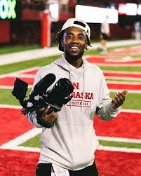
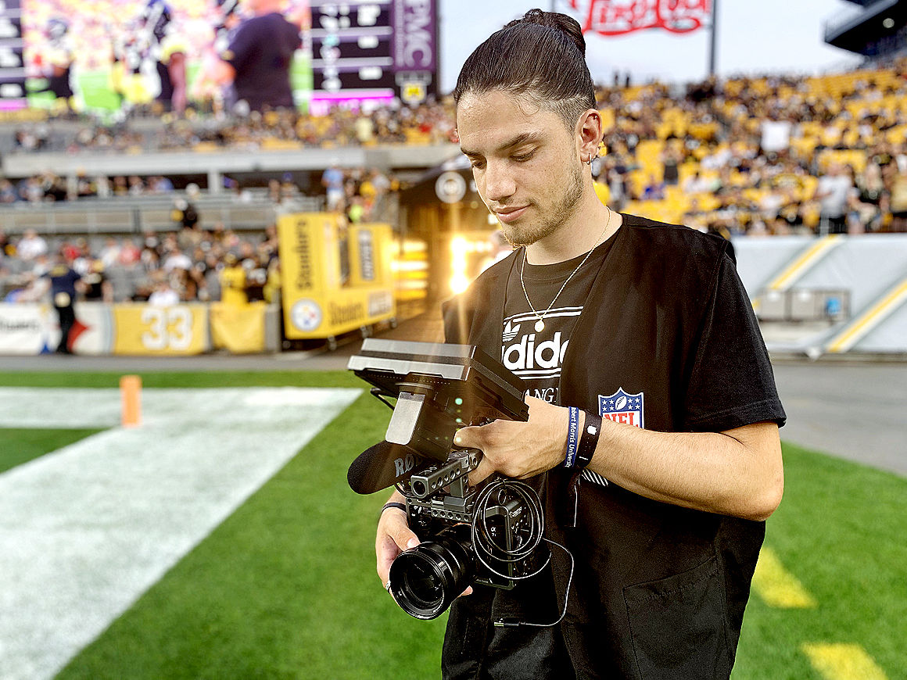
What is sports videographer
As a sports videographer, you attend all types of games and events to shoot footage of athletes in action to be used for highlights,a news broadcast, sports channel shows, websites, and advertisements. Your duties include composing and framing each shot and utilizing technical aspects such as filters and various camera settings. With this job you are hands on with the camera. You will build relationships and connections with athlete's your filming and people watching your content.

Slide 3
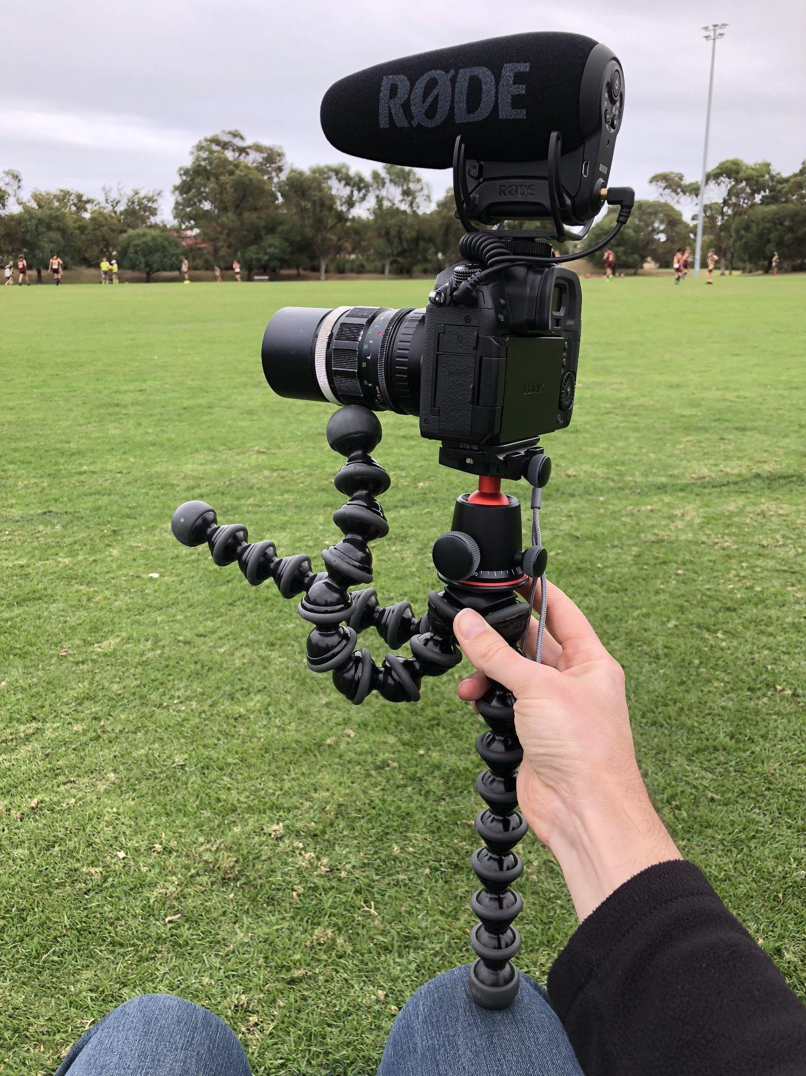
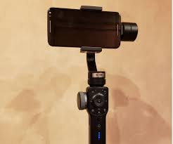
Devices
You can use almost anything to record for sports videography from almost any device that can record. For starters some people start off with their phones and continue to build as they grow upgrading to s small type camera, all the way to one of the best cameras in the game

Slide 4
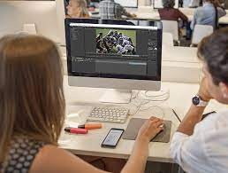
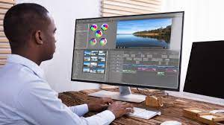
Sports Videography Editing
Video editing is a whole different game within the sports videography. They both rely into the same context but are two different gameplans. Videography editing consists of a behind the scene tasks nobody really sees, using different softwares of your liking , adding your music, effects, and your own touch to make the video special. This part of the process is less fun to others because of the time it takes.

Slide 5
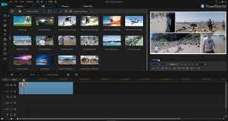
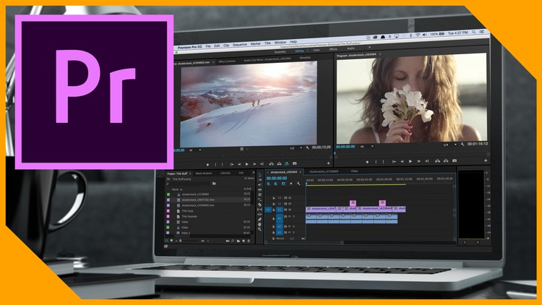
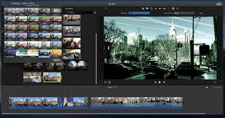
Editing softwares
Adobe Premiere Pro
CyberLink
Pinnacle Studio
Imovie
Headliner

Slide 6




Examples of Videographers/ Editors
Athlazon
The Dzone
SportsInTheD
HighlightHiggy
Or even myself
All based out of Detroit,Michigan

Slide 7
Levels of Videography editing
Level 1- Level 1 sports videography editing would be a basic process of just combining clips together and adding music or your brands watermark to footage you have recorded or have been sent.

Slide 8
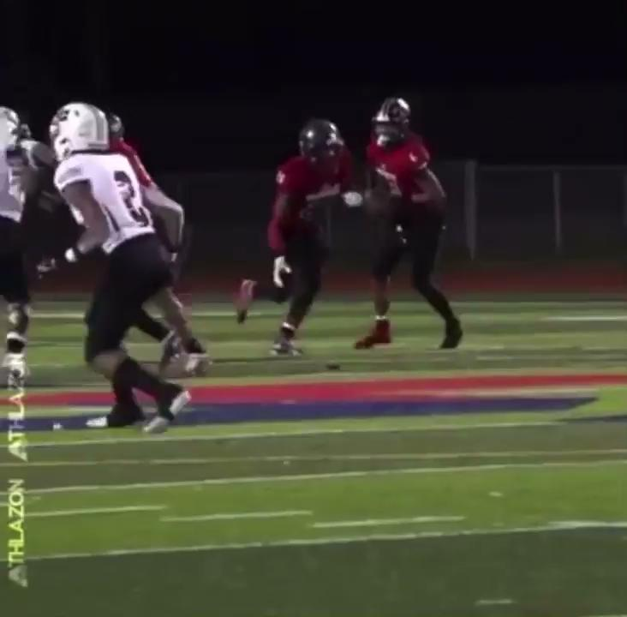

Examples of Level 1 editing work
Athlazon
TheDzone
TheDzone

Slide 9
Level 2
Level 2- Level 2 of sports videography editing would be having your basic process of level 1 but even adding a mini twist such as a few affects but nothing outrageous.

Slide 10
Examples of Level 2 Editing work

Slide 11
Level 3
Level 3- Level 3 of sports videography editing is a continuation of level 1 and 2 but also the process of adding more effects and screen visual this tends to take more time and usually occurs in longer videos. Such as a whole reel of a player .

Slide 12
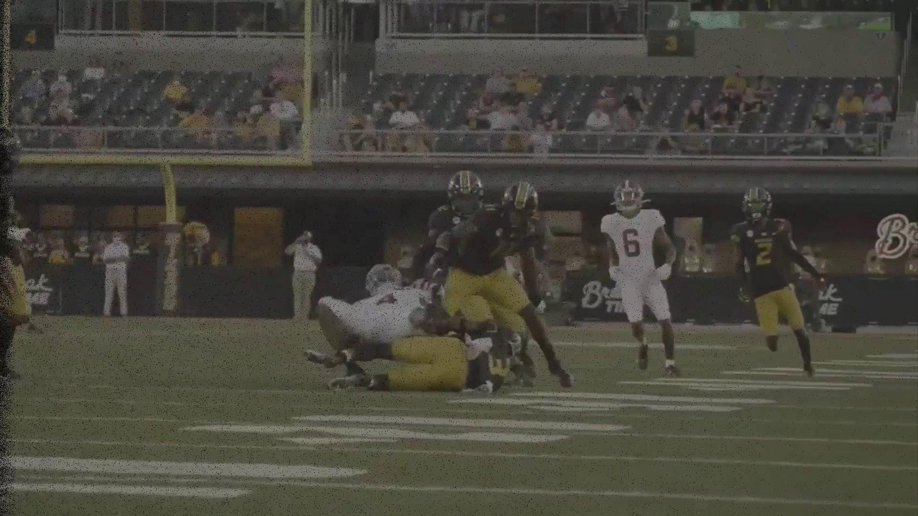
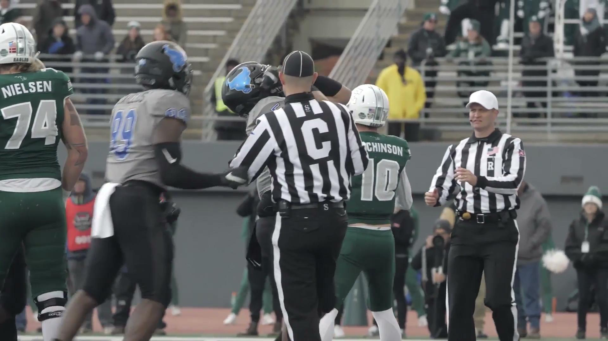
Examples of Level 3 editing work

Slide 13
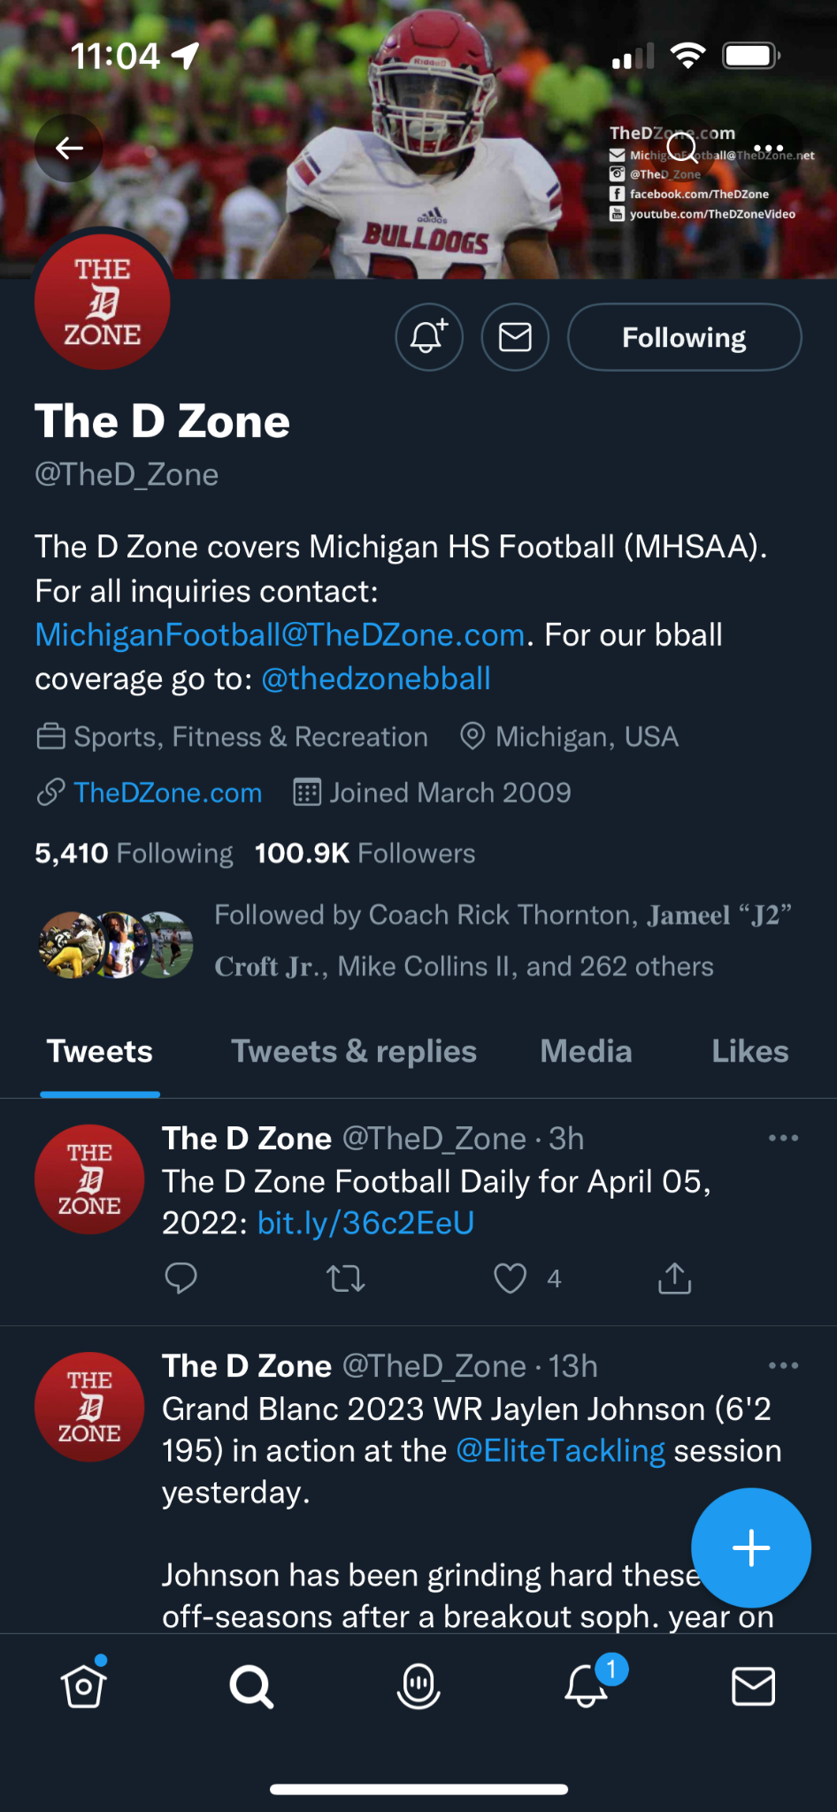
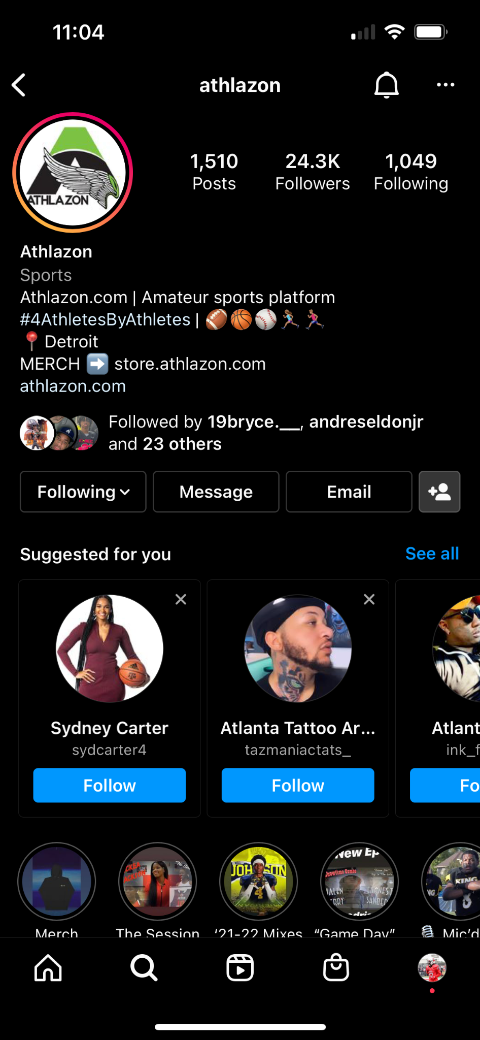
Getting your exposure
Starting your exposure starts with creating your social media and finding people to start recording. Remember you always start from somewhere.

Slide 14
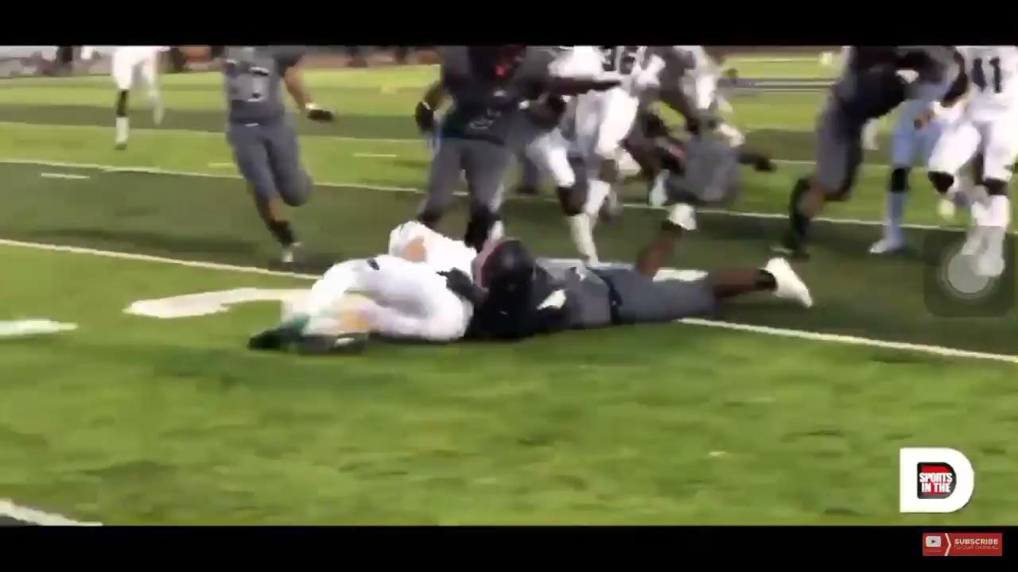
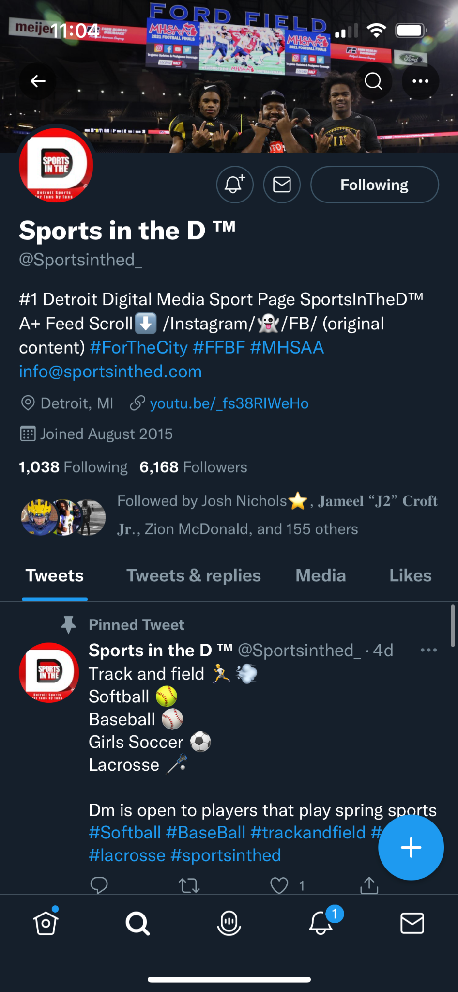
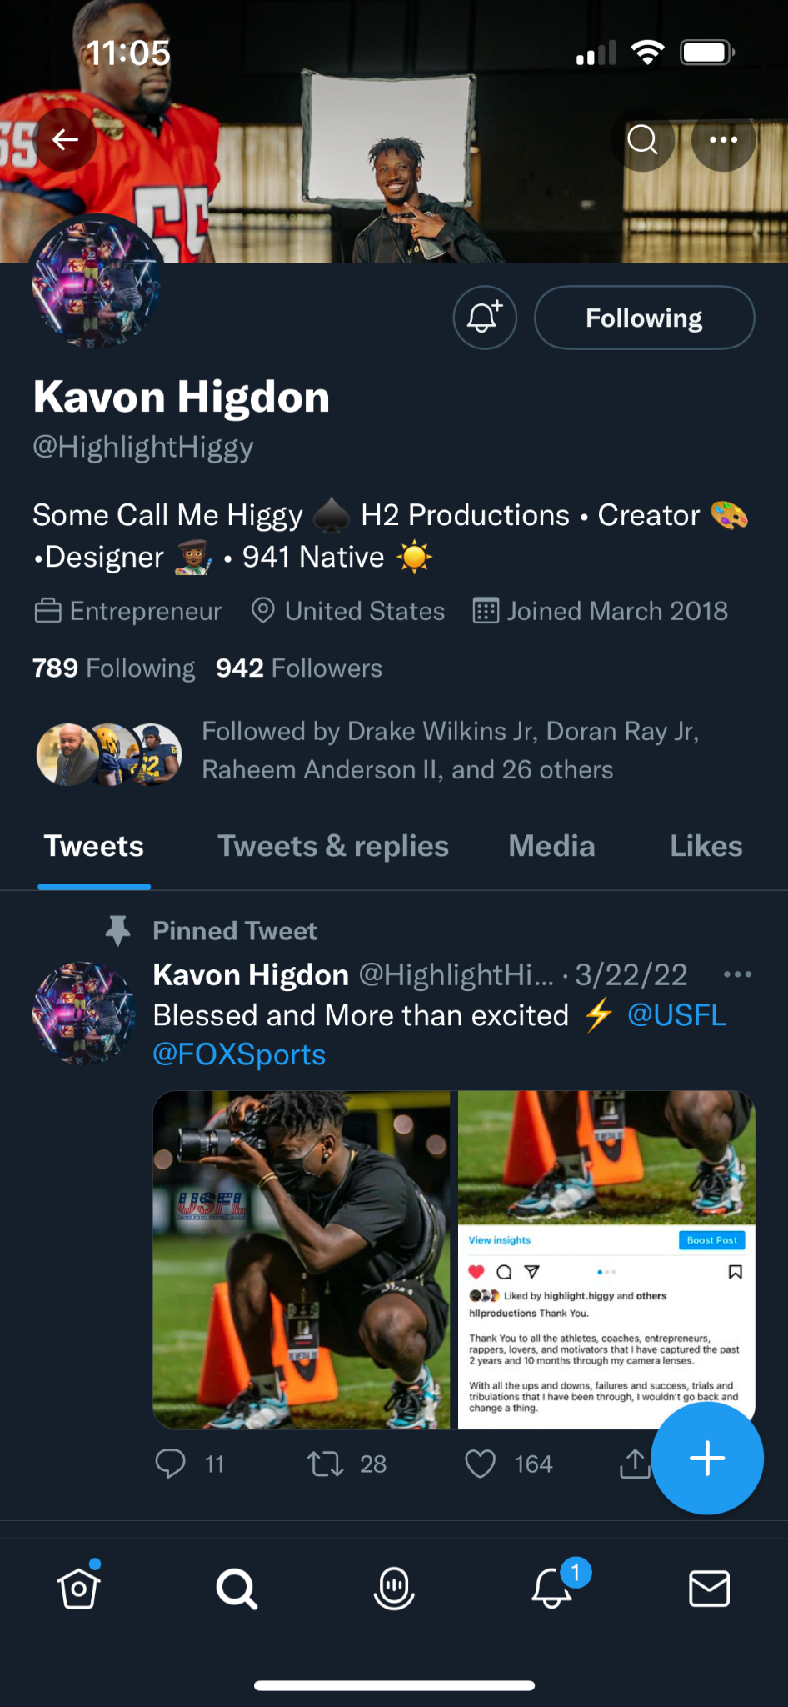
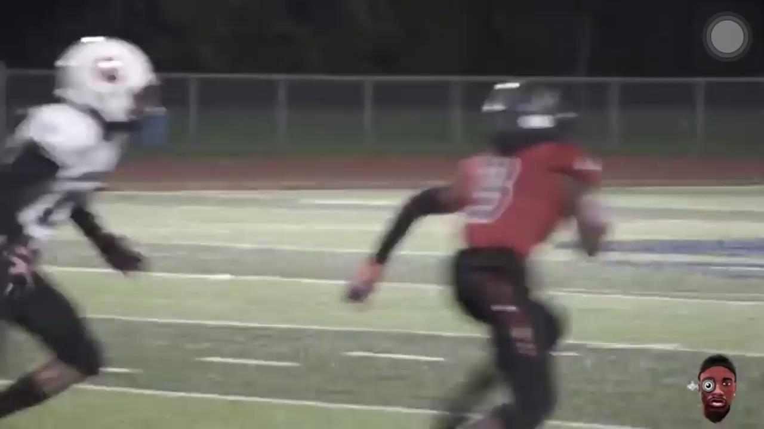
Examples of starting your exposure

Slide 15
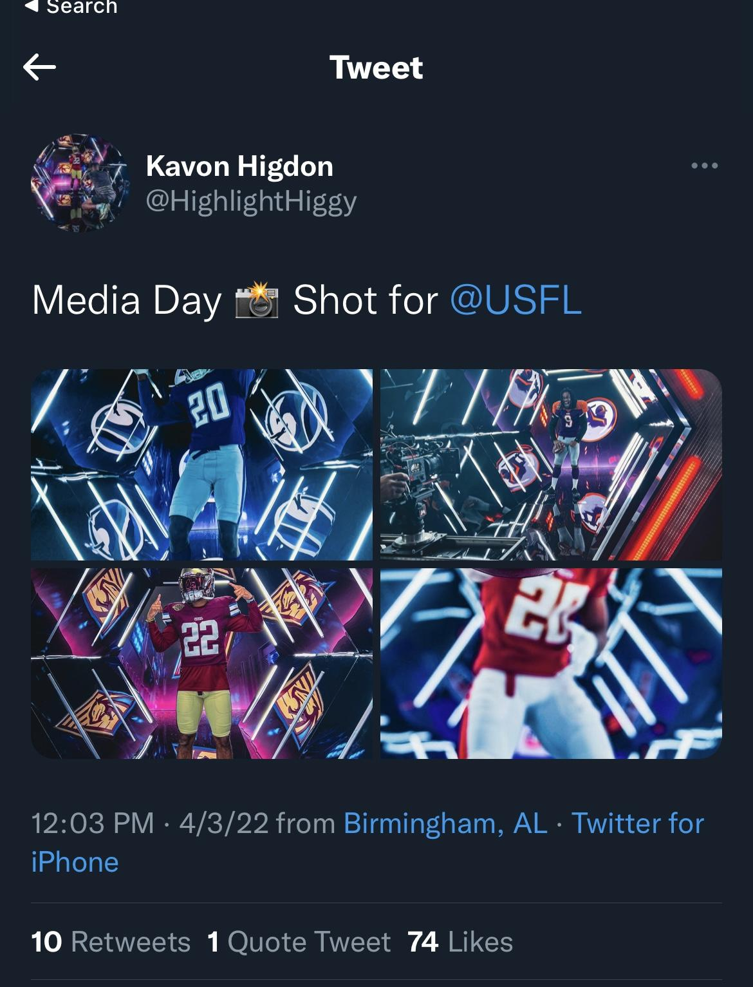
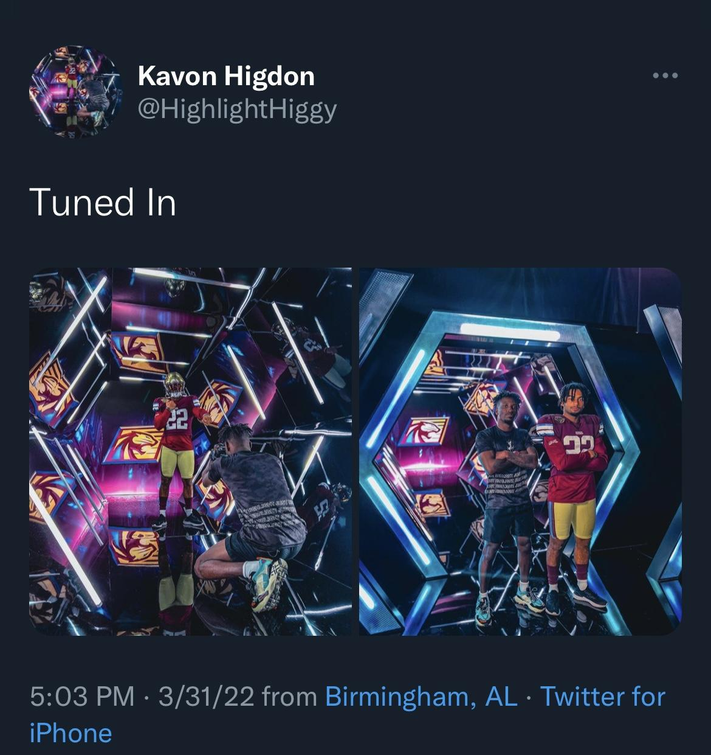

Slide 16
Questions??

